Slide 1

Kind0, from 0 to fAngle =atan(dimx/dimy)
newAngle
newAngle
newAngle
Kind1, TRANSPOSED, from fAngle to 90
Kind2, TRANSPOSED, MIRRORED, 90 to 180-fAngle
Kind1
Kind2
Kind3
Kind0
newAngle
Kind2, MIRRORED, 180-fAngle to 180

Slide 2
dim_i
newAngle
A
offset
drift
dim_o
target
weight
T
target+1
1-weight
skewHeight
After processing, the output value for A is
the weighted average from Tb and Ta.
Input data in A is projected in target points Tb and Ta, that is,
Ta=(i+target,j) and Tb=(i+target+1,j) using a weighted average.
Texts and lines in red are equally valids for any row i. It only depend on j

Slide 3
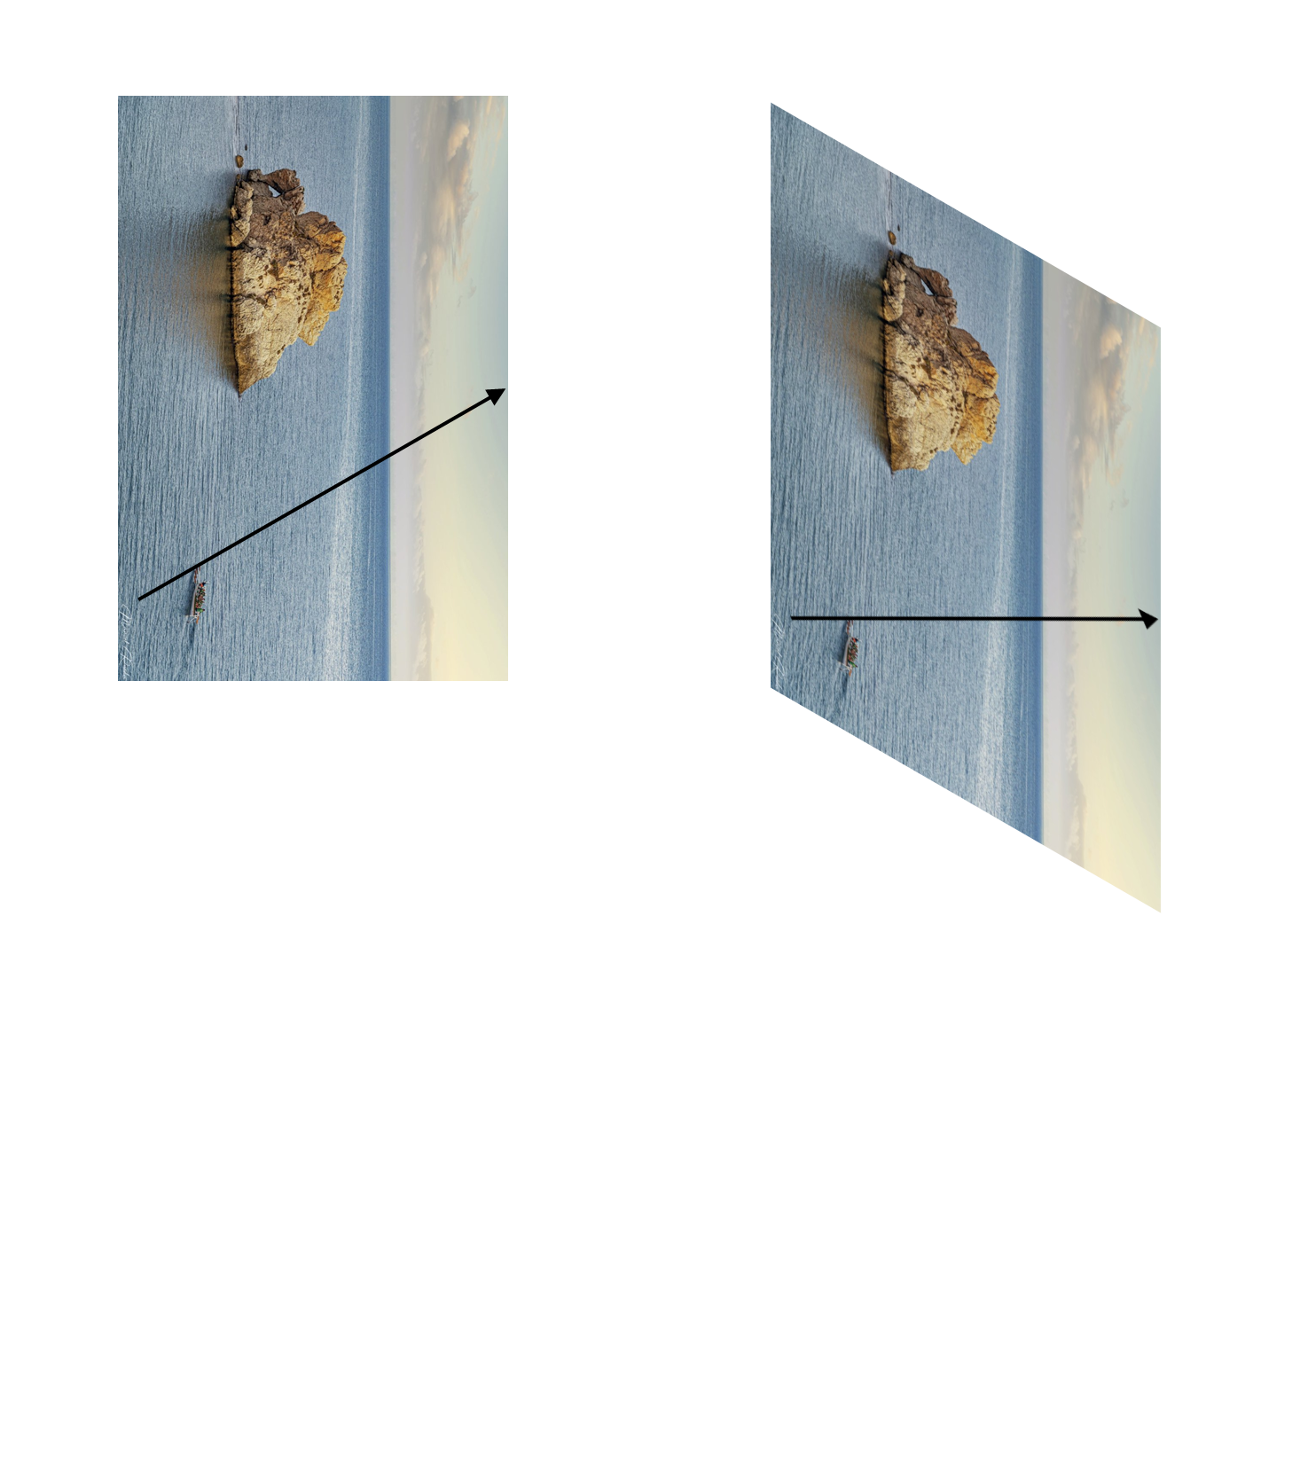
0
newAngle
first(i)
last(i)
newAngle
skewHeight-1

Slide 4
newAngle
newAngle
newAngle
newAngle

Slide 5
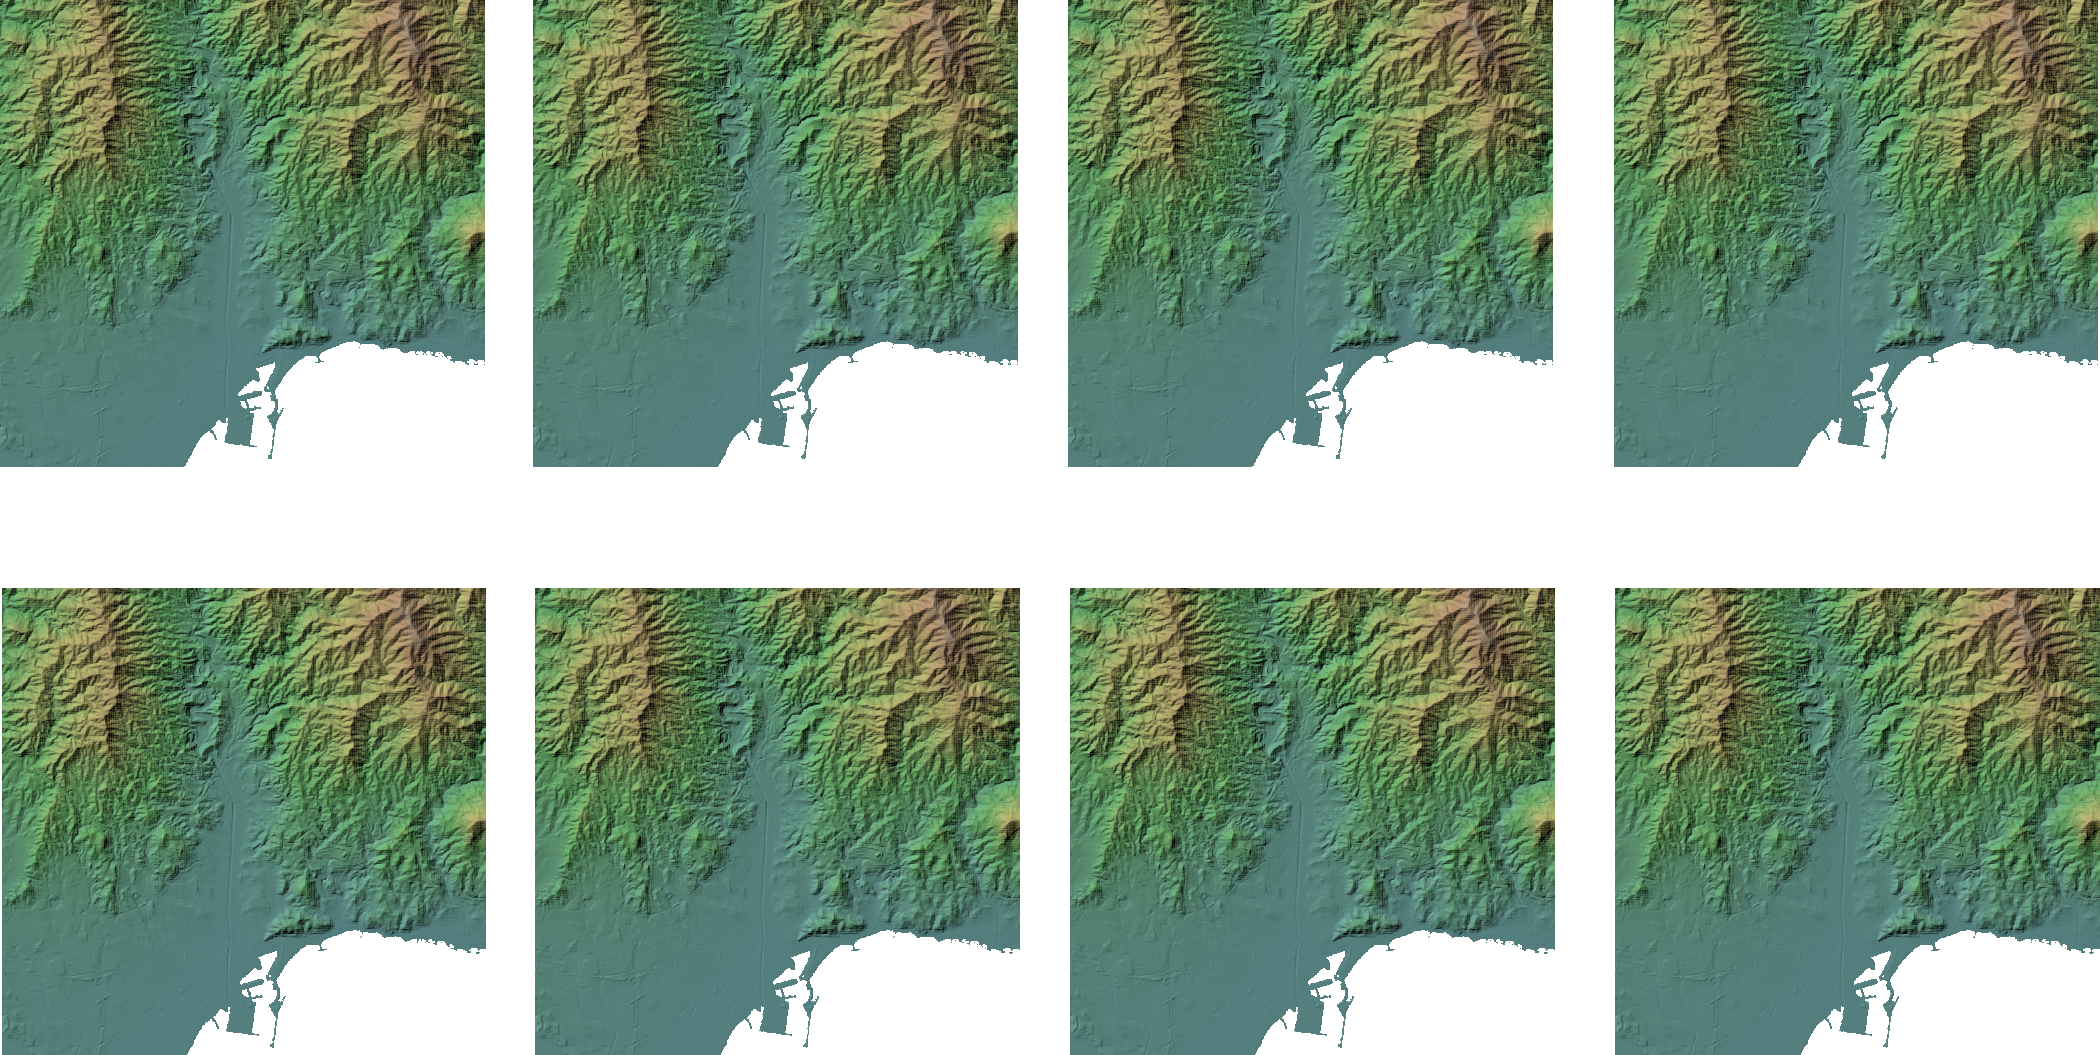
Outer loop: points
Inner loop: directions
Outer loop: directions
Inner loop: points

